Slide 1

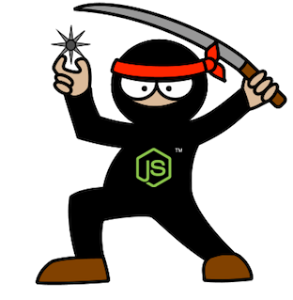
Supersize Node.js –
M&E Cloud Service Journey
Guillaume Brossard
David Richer
Sr. Engineer – M&E Cloud Services
Sr. Engineer – M&E Cloud Services
Notes:
V1.0

Slide 2

M&E Cloud Services - Context
Open the Cloud to Artists and Managers
Multi-team, using a Core Services stack
Notes:
In January 2013, M&E started a new initiative named named Cloud Services. David and myself were among the first members of that group. We were to be responsible, among other things, of the deployment of the stack.
Our mission:
Open the Cloud to Artists and Managers using M&E products
Empower our users with collaboration features
The Product:
Was to be develop by a group composed of many teams, using a Core Services stack. There was to be in-DCC integration in product like Flame, Maya, and 3DS Max. There was also plan to have dedicated Web Services like Rendering and Simplification.
Multi-team
In-DCC integration
Tray Application
Specialized Web Services
Core stack for inter-operability
Challenge:
Build a deployment process flexible enough to support deployment of multiple products with different release cycles.
None of the products where precisely defined initially

Slide 3
Deployment Goals
Easy deployment
Repeatable
Small pieces to build something big
“Developer-centric” environment
Notes:
Easy Deployment
Sync and run script
Repeatable
We wanted to be able to re-deploy any given version of the stack, at any time.
Small pieces to build something big
“Developer-centric” environment
Developers don’t have to think about deployment in their day-to-day tasks
Development fluidity is key

Slide 4
Architecture Oversight
Notes:
At the beginning, we didn’t knew much about the final architecture of the system.
What we knew
The stack would be composed of many services.
Services would need to be scalable.
Configuration would change regularly.
Deployment on Unix, development on any platform, mainly Windows.
From deploying services, our mind set changed to deploying a set of instances, playing one or many roles. Thinking in terms of roles means that the topology can be configured dynamically, increasing our capability of changing the stack configuration. (Dynamic Layouting of Roles)

Slide 5
Architecture How Node.js Tinted the Architecture
Notes:
Another thing we knew from the start was that our stack would be build around Node.js
How does Node.js tinted the architecture:
Not much dependencies
Encourage development of small services
Reusable modules
Web Storage (npm registry, Git)
Npm is the Node.js package manager, similar to apt-get

Slide 6
Architecture Amazon
Notes:
The third fixed variable in our setup was that the stack would be deployed on Amazon.
What a great news. Amazon offers a multitude of tools that makes developers life easier:
Deployment
Cloud Formation
Scaling
Elastic Load Balancers
Auto-Scaling Groups
Security
Virtual Private Cloud
Services vs. DB Stack
DNSing
Route 53
NAT Instance
Now I am going to give the floor to David, who will give more details about the different steps of our Node.js deployment.

Slide 7

Deployment as code
Everything in source control
Sync and deploy
Use a different repository from the code
Branch and tag in deployment repository
Notes:
Everything in source control
We choose enterprise GitHub to store our application and node modules.
Script
Config
Installer for tools
Sync and deploy
Use a different repository from the code
Code and deployment don’t evolve at the same speed
Branch and tag in deployment repository
Release management like for the code

Slide 8
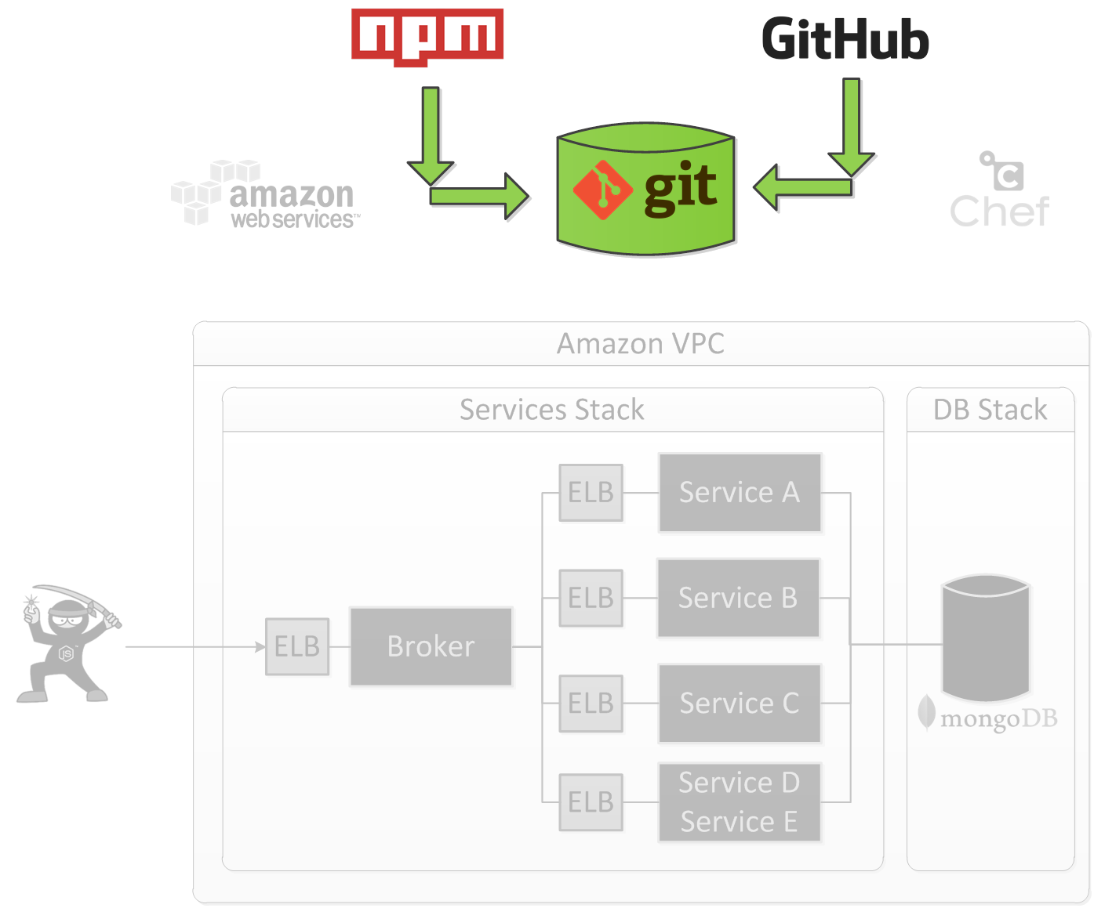
Publish
Notes:
Introduction
Create a package ready for deployment
Break dependency from npm registry and git Autodesk
Faster to deploy

Slide 9
Publish
Notes:
Install
Install module from npm registry
Install module from Autodesk private git repository
Publish
Gitolite
Node.js Modules
Decoupling from npm registry and git
Deploy

Slide 10
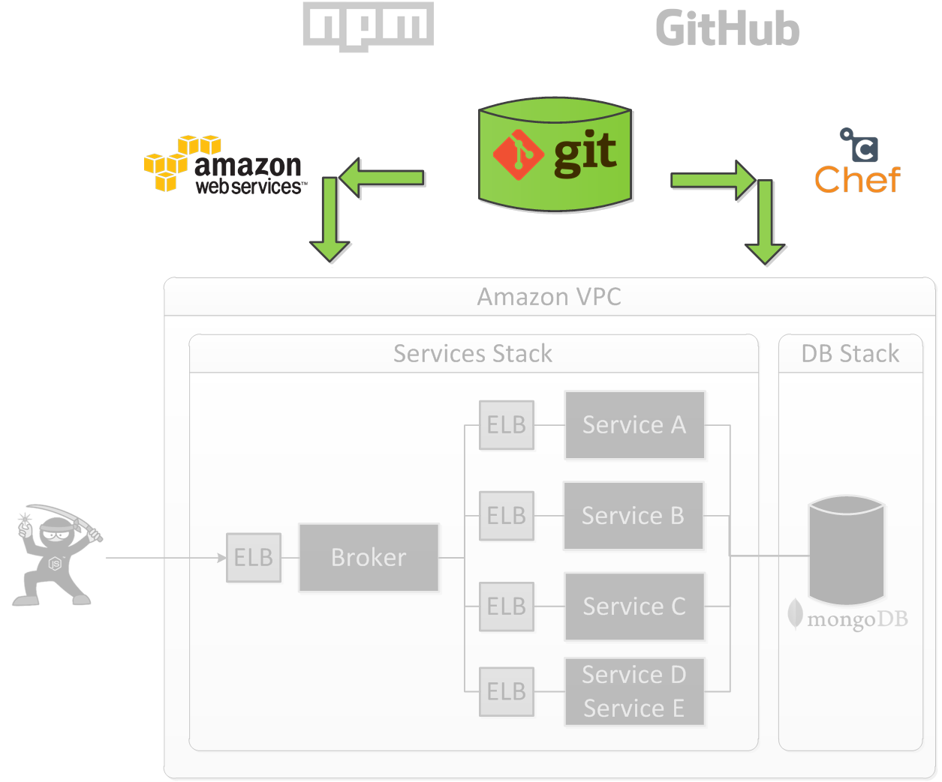
Provisioning

Slide 11
Cloud Formation
JSON file
Template generation
Create and delete stack
Update existing stack
Notes:
JSON File
Describe all resources in the stack
Template generation
A need for a simpler representation with less duplication
Create and delete stack
Easy stack management
Update existing stack
Amazing capability to analyze the difference and only update needed resource
Talk about rolling update for AutoScaling group

Slide 12

Machine Provisioning
Chef
Roles
Upstart
Notes:
Definition of the provisioning a machine
Configure a vanilla Linux machine to be ready to operate
Roles and Chef
- Why Chef? Community cookbooks
Upstart
- Helpful ubuntu tools to start and monitor a process. Restart node process ready fast after a crash.
Vagrant
Great way to quickly test Chef cookbooks
We had greater plan for Vagrant usage at the beginning but we only use it to test cookbooks.

Slide 13
Provisioning - Chronology
Notes:
Steps from a vanilla Ubuntu image to a machine running our service
Image
We choose to not start from a baked image because the provisioning time is still low 5 minutes.
We see image generation as an optimization.

Slide 14
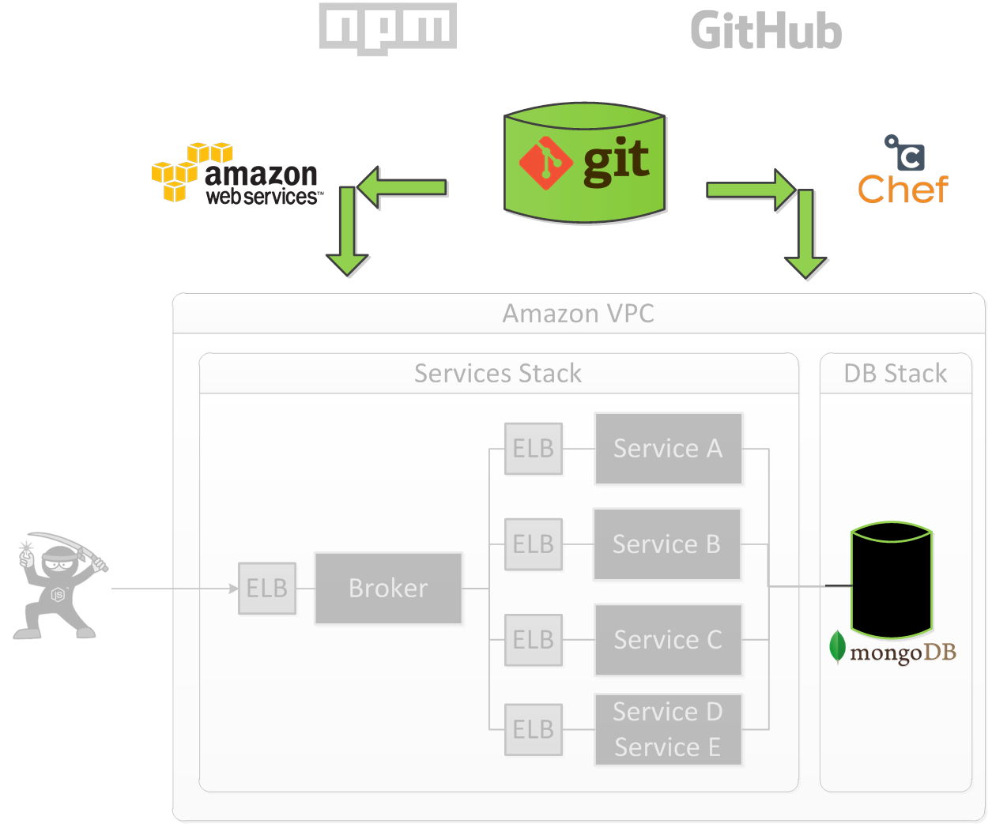
Provisioning - MongoDB
Notes:
Main Data Store is MongoDB

Slide 15
MongoDB – Replica Set
Notes:
Introduction to our MongoDB setup
We use a replica set, will use sharding in the future when it will ne needed.
We use three machines in different Amazon Availability zone
We do the database backup by doing a EBS snapshot of one of the secondary machine
For the logging database, no need for replica set or backup, not system critical but still annoying.

Slide 16
MongoDB – Chronology
Notes:
We use an existing Mongo cookook to install and configure Mongo.
Provision Secondaries
Install Mongo
Start Mongo
Provision Primary
Install Mongo
Restore Snapshot
- We start from an EBS Snapshot
Initialize Replica Set
Elect a new master, always the same
Data replication from master to both secondary
Data Migration
- Run a node.js application to upgrade the data as needed.
Provision Service Stack
Comments
- Room for optimization take 30 minutes to be ready

Slide 17
Stack Family
Notes:
Fixed URL that are alias to a real stack that can change overtime.
Develop is the latest version of the code, updated at least one time per week.
Staging is used to test the next version that will be deployed in production. Used mostly during stabilization period before updating the production stack.
Production is the live stack, updated lot less often, once every month.
Each stack family has his own data, this allow to properly test data migration.
Seems obvious; but we delayed it a bit and it causes us issues.
Now, I let Guillaume talk about stack monitoring.

Slide 18
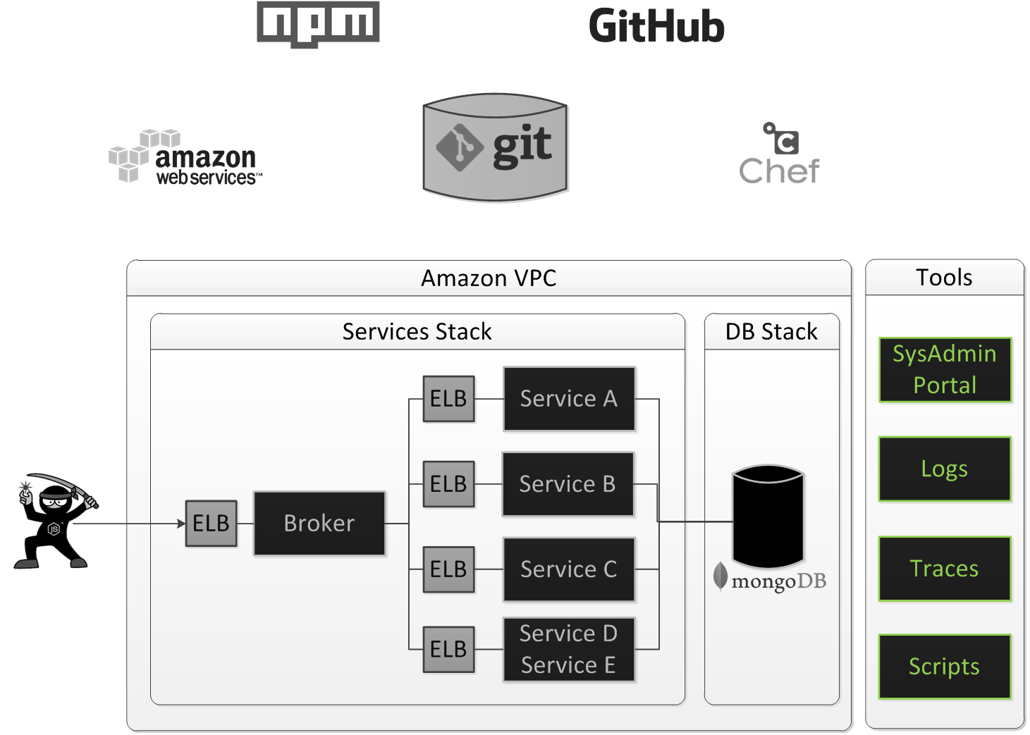
Tools
Notes:
For us, Deployment and scaling is not just a matter of creating the stack in the cloud. It’s also about providing developers tools to be able to manage and control that scaling.
Amazon already offers a lot of tools and metrics at the instance level, but we soon found out we needed more information about the services themselves.

Slide 19
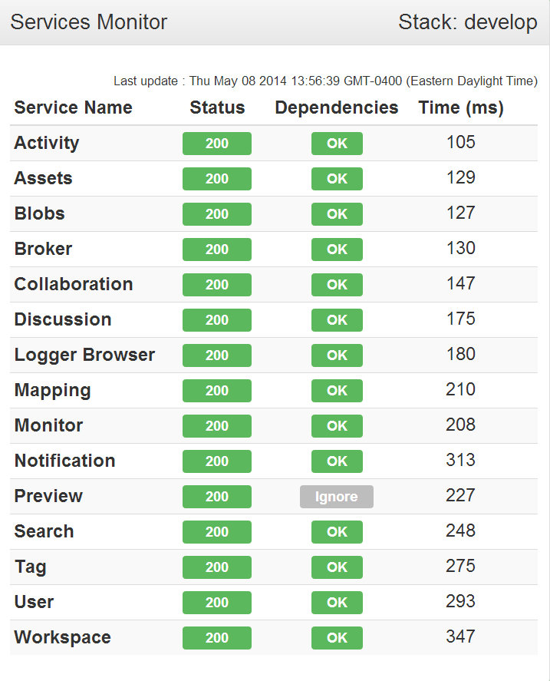
Stack Monitoring
Sys Admin Portal
Monitor Page
Logs
Tracing
Notes:
Early in the life of our product, we created a SysAdmin Portal to allow developers and SysAdmin to introspec what is going on in the stack.
To know the state of the stack and what happens in the past.
Monitor page show the individual status of each services and their dependencies.
Dynamic service logs
Tracing

Slide 20
Logs Architecture
Notes:
It’s important that developers have the feeling that they can rely on the logs.
Use at will
Will not slow the stack
To prevent logs from slowing down the system
RabbitMQ queue to control the flow of logs message in case of huge spikes.
MongoDB capped collection to limit the logs size
Different level of logs (fatal, error, warning, info)
Logger Watcher
Notify SysAdmin when something unexpected happen
Filter (level, service, poll interval)

Slide 21
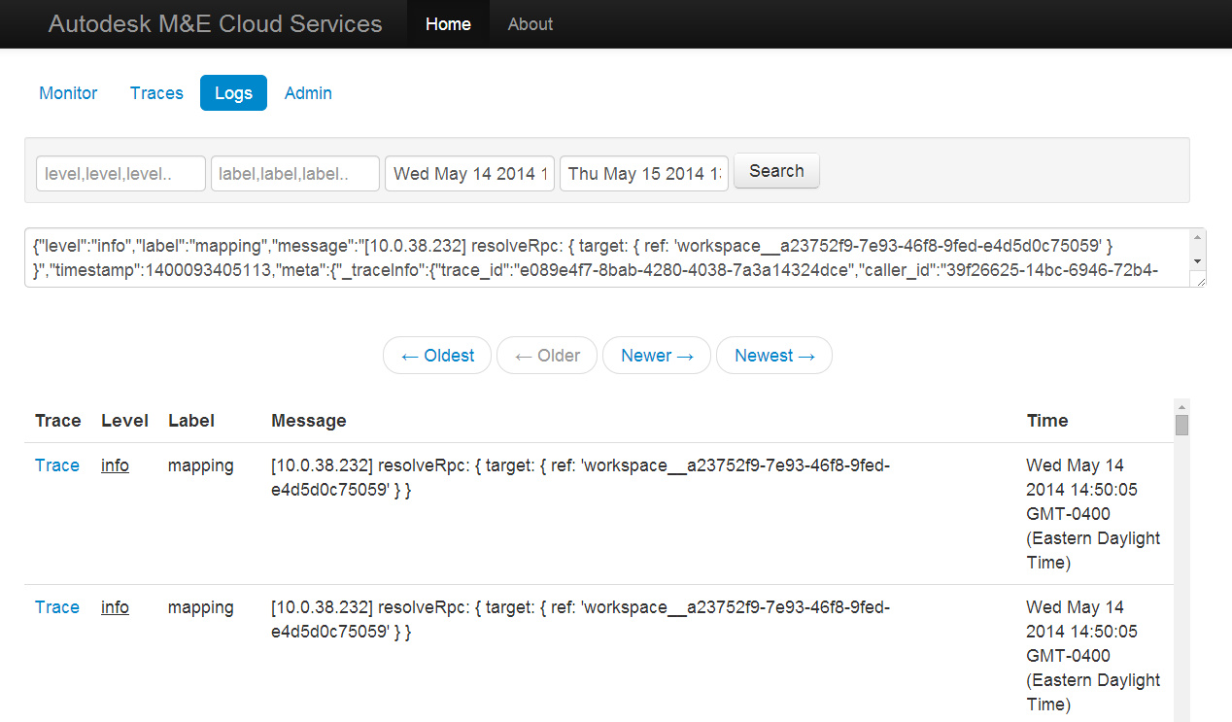
Logs
Notes:
One of the first service/tool we worked on.
Currently working on a refresh.

Slide 22
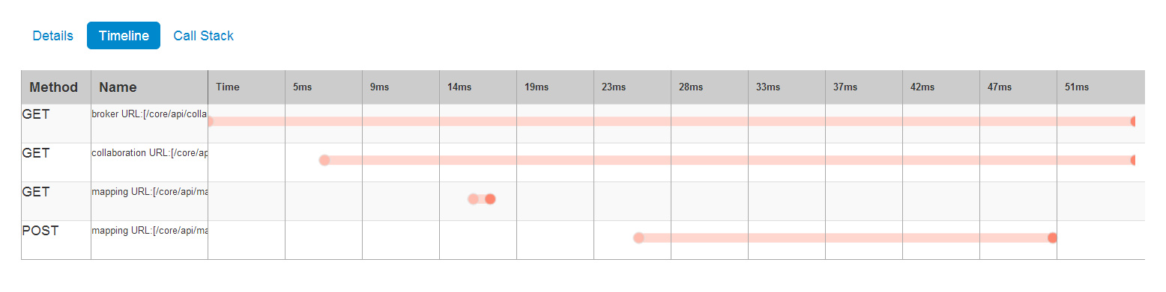
Tracing
Notes:
Built using the same architecture as logs.
Allow us to follow a request in the system, from the user through each services and back to the user.

Slide 23
Stack Diagnostic and Debugging
Access the stack using ssh
Scripts
Tunnel to any instance
Tunnel to MongoDB using RoboMongo
Node.js remote debugging
Security, security, security!
Security groups, ip filtering, encrypted keys
Notes:
In the continuation of providing developers with tools, we worked on a set of scripts to help developers debugging their services.
We can basically access any services in the stack with a simple command.
Create a tunnel to any instance
Tunnel to MongoDB, allowing use of MongoDB admin tools like RoboMongo
Node.js remote debugging

Slide 24
Lessons Learned The Good Parts
Deployment from day 1
Investment in development/deployment tools
“Local” Deployment
Shared Configuration (nconf)
Notes:
Deployment from day 1
Working on deployment from day 1 is a really good idea. You end up investing a lot of time in your deployment. You also makes mistake and identify workflow issue on usage, so the more you use it, the earlier you are going to identify and improve your process.
Investment in development/deployment tools
Do not wait to hit a problem before putting tools in place. There is nothing worst than trying to resolve a problem blindly.
“Local” Deployment
Cross-platform technology
“Full” JavaScript stack
Shared Configuration (nconf)
Services often needs information about other services, like IP addresses, API entry-points, keys, etc. Using a configuration mechanism is a good way to share that knowledge. It allows for different configuration in development vs. production and to configure the services on-the-go. We choose nconf, a hierarchical NodeJS configuration, and we recommend it greatly.

Slide 25

Lessons Learned The Bad Parts
Cloud Formation Abstraction
Npm registry
Private registry would be preferable
npm lazy
Vagrant
Notes:
Cloud Formation template generation abstraction
From the start, we identified that this was going to be an issue. We are using Mustache templates to generate our templates. It turns out it is not the right tool to do that. Mustache is a logic-less, and we would have needed logic. Handlebars would have been more suited to the task.
Npm registry
We correctly decoupled deployment from npm registry, and that solidified our deployment process. From a development perspective, however, there is still room for improvement.
Git protocol for node modules works, but it is slow + not reliable
Fetching from npm is not fast
Private npm registry would be preferable
Middle-ground solution with npm lazy
Vagrant
Vagrant is a tool that allow creation and management of Virtual Machines using code. Our plan was to allow to create a small cloud running on a developer machine to replace the full deployment. We have nothing to say against Vagrant; it is great, easy to use. But due to Node, it turns out that still today, every developer can start in 10 seconds the complete stack on is computer, so we didn’t have much use for it.

Slide 26
Notes:
One of the first service/tool we worked on.
Currently working on a refresh.

